Slide 1
CSE460: VLSI Design
Lecture 8: Logic Function Synthesis using k-map

Slide 2
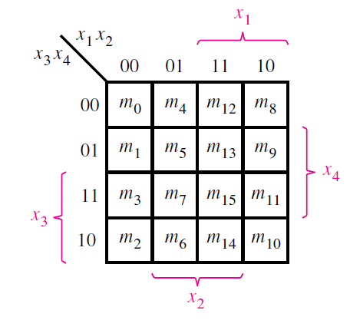
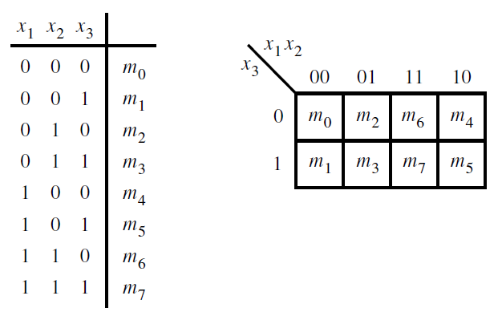
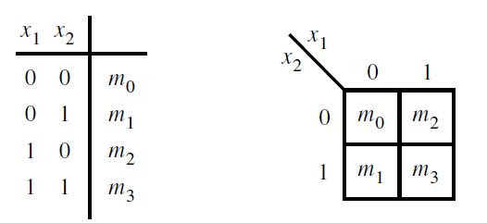
Review: Logic Function Synthesis using k-map
The Karnaugh map (or k-map) is an alternative to the truth-table form for representing a function
The map consists of cells that correspond to the rows of the truth table

Slide 3
Logic Function Synthesis (SOP) using k-map
Consider a logic function, Y = f(A,B)
Minterm (SOP) - Group 2^{n} no. of 1 and skip 0. n = 0,1,2,3…. (Make groups larger as possible)
Grouping can be square/rectangle shaped or along row/column (Not along diagonal). Groups can be overlapped.
The inputs which are varying in a group, can be omitted. The others (fixed) can be written as product form. Invert the variables which are fixed with the value 0.
Don’t cares (d) can be used 0/1 as per convenience.
A | B | Y
0 | 0 | 0
0 | 1 | 1
1 | 0 | 0
1 | 1 | 1
K-map:
A | B | Y
0 | 0 | 1
0 | 1 | 0
1 | 0 | 1
1 | 1 | 0
B
A
0
1
A omitted.
B fixed with 1.
Y = B
0
0 | 1
0 | 1
Y = B’
1

Slide 4
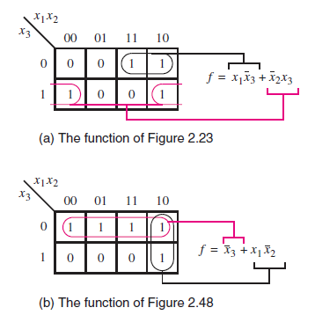
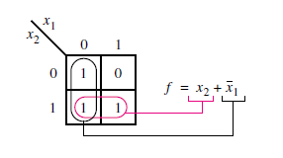
Logic Function Synthesis (SOP) using k-map
Minterm (SOP) - Group 2^{n} no. of 1 and no 0. n = 0,1,2,3…. (Make groups larger as possible)
Grouping can be square/rectangle shaped or along row/column (Not along diagonal). Groups can be overlapped.
The inputs which are varying in a group, can be omitted.
Don’t cares (d) can be used 0/1 as per convenience.
Edges are connected.

Slide 5
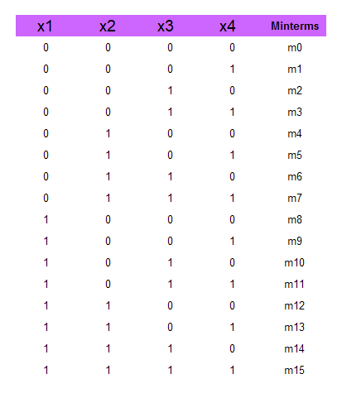
Logic Function Synthesis (SOP) using k-map
Consider the following function (where m= minterms, D = don’t cares):
f(x1, . . . , x4) = ∑ m(2, 4, 5, 6, 10) + D(12, 13, 14, 15)

Slide 6
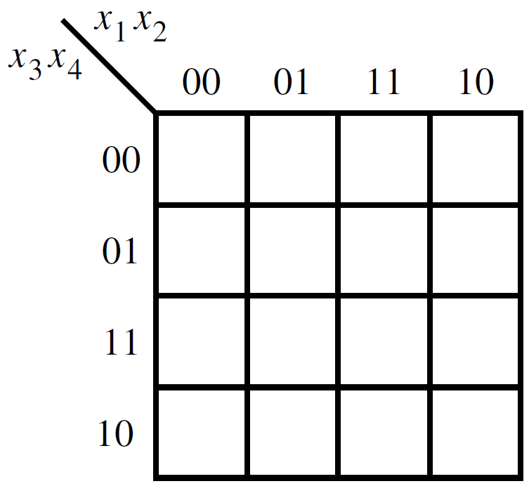
Logic Function Synthesis (SOP) using k-map
Consider the following function (where m= minterms, D = don’t cares):
f(x1, . . . , x4) = ∑ m(2, 4, 5, 6, 10) + D(12, 13, 14, 15)

Slide 7
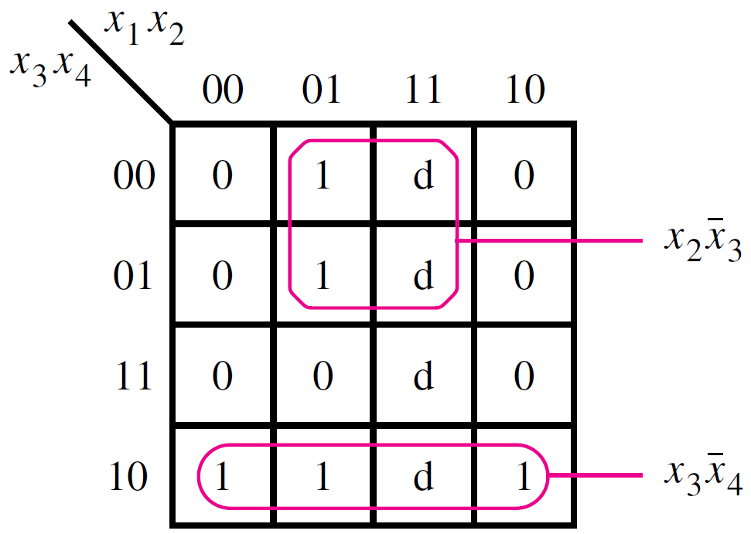
Logic Function Synthesis (SOP) using k-map
Consider the following function (where m= minterms, D = don’t cares):
f(x1, . . . , x4) = ∑ m(2, 4, 5, 6, 10) + D(12, 13, 14, 15)

Slide 8
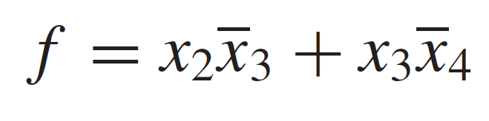
Logic Function Synthesis (SOP) using k-map
Consider the following function (where m= minterms, D = don’t cares):
f(x1, . . . , x4) = ∑ m(2, 4, 5, 6, 10) + D(12, 13, 14, 15)

